Slide 1
OOP Semester Project • BSE-2A
Banking Management
System
A full-featured Qt/C++ desktop banking application with dual-theme UI, secure authentication, and real-time transaction management.
Muhammad Hammad Ateeq (047) | Muhammad Shayan Chaudhary (061) | Bahria University

Slide 2
Table of Contents
01
Project Overview
05
OOP Concepts
Goals, scope and technology stack
Encapsulation, Inheritance, Polymorphism & more
02
System Architecture
06
Team Contributions
Module hierarchy, component flow & ER Diagram
Individual responsibilities
03
Key Features
Core capabilities of the application
04
UI Showcase
15 screenshot slides — all screens incl. Admin Dashboard

Slide 3
01 — Project Overview
A secure, professional desktop banking application built with Qt6 and C++17
What It Is
Project Goals
Tech Stack
› Full-stack desktop banking app
› Apply OOP principles in practice
› Language: C++17
› Secure login & user registration
› Build a production-grade UI with Qt
› UI Framework: Qt6 Widgets
› Real-time balance tracking
› Implement database-backed features
› Database: MySQL (Qt Sql)
› Deposit, Withdraw & Transfer
› Achieve a dual-theme design system
› Build: CMake 3.16+
› TPIN-secured transactions
› Demonstrate secure architecture
› IDE: Qt Creator
› Transaction history table
› Deliver a real-world project
› Design: QSS Stylesheets

Slide 4
02 — System Architecture
Module hierarchy and component relationships
MainWindow
Supporting Classes
BankDB
QStackedWidget — orchestrates all pages
MySQL database layer
LoginWindow
SignupWindow
DashboardWindow (Shell)
UserSessionHandler
Active session DTO
Authentication UI
Registration UI
UserDashboard + AdminDashboard
inherits
TransactionDialog
BasePage (Base Class)
inherits
inherits
Deposit / Withdraw / Transfer

Slide 5
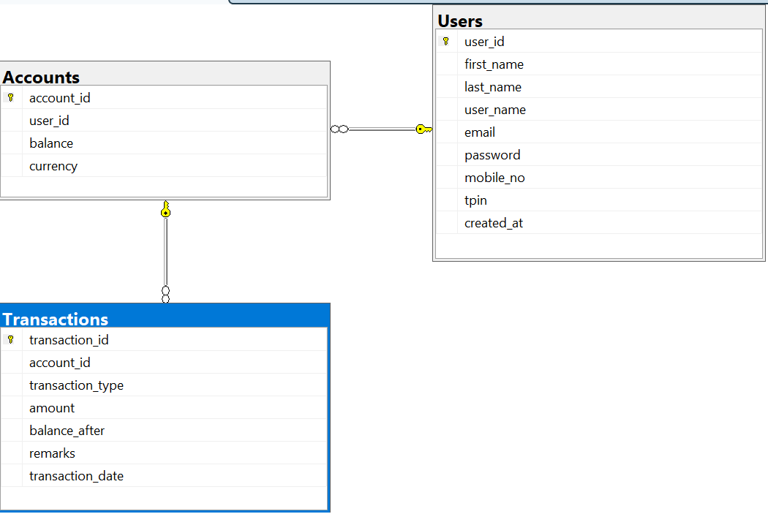
02 — Database: ER Diagram
Entity-relationship structure of the MySQL database
INSERT ER DIAGRAM IMAGE HERE
Delete this box → Insert > Picture → select your ER diagram export
Users
Accounts
Transactions

Slide 6
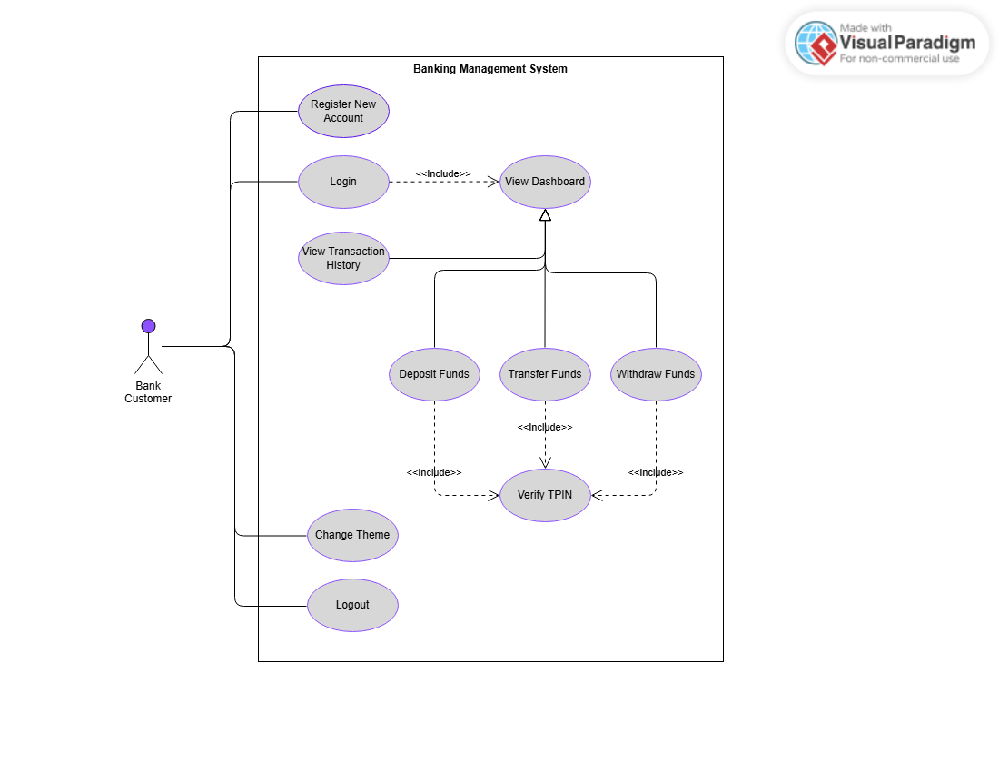
02 — UML: Use Case Diagram: Customer
This use case diagram shows all the use cases in the system.

Slide 7
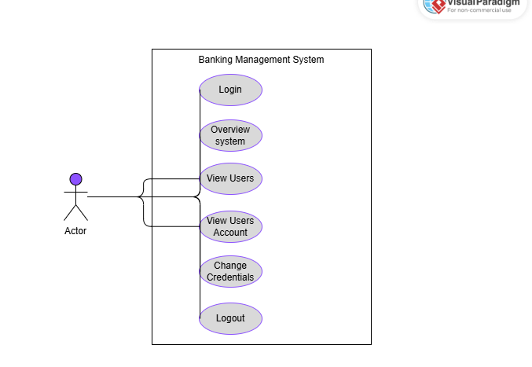
02 — UML: Use Case Diagram: Admin
This use case diagram shows all the use cases in the system.

Slide 8
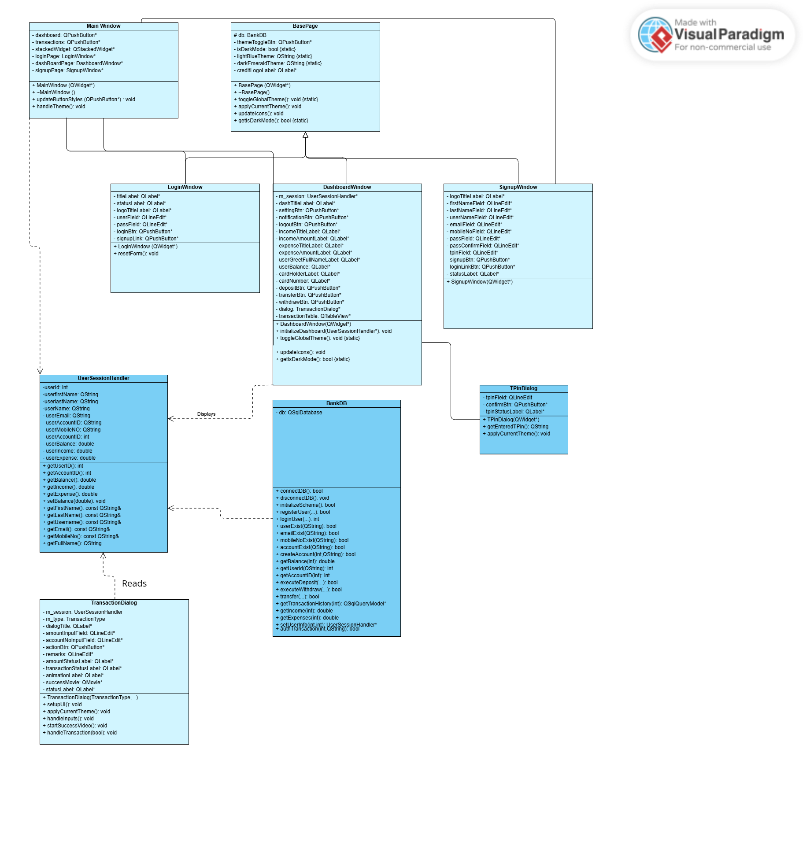
02 — UML: Class Diagram
This use case diagram shows all the use cases in the system.

Slide 9
03 — Key Features
Core capabilities delivered in this application
Secure Authentication
Live Dashboard
Transaction Engine
Username + password login with credential verification. Registration with full field validation. Session-based access control after login.
Real-time balance on a styled debit card widget. Income, expense & savings summary cards. Full transaction history table.
Deposit, Withdraw and Transfer to other accounts. Every transaction TPIN-verified. Input validation before any database write.
Dual-Theme System
TPIN Security
Admin Dashboard
Light Blue and Dark Emerald themes toggle globally. All windows, dialogs and cards update simultaneously via a static flag.
A 4-digit Transaction PIN protects all fund movements. Numeric validator, disabled confirm until length is complete.
Dedicated admin control panel with 4 tabs: Overview (system-wide stats), Users (searchable table), Accounts (all balances) and Credentials (change admin username/password).

Slide 10
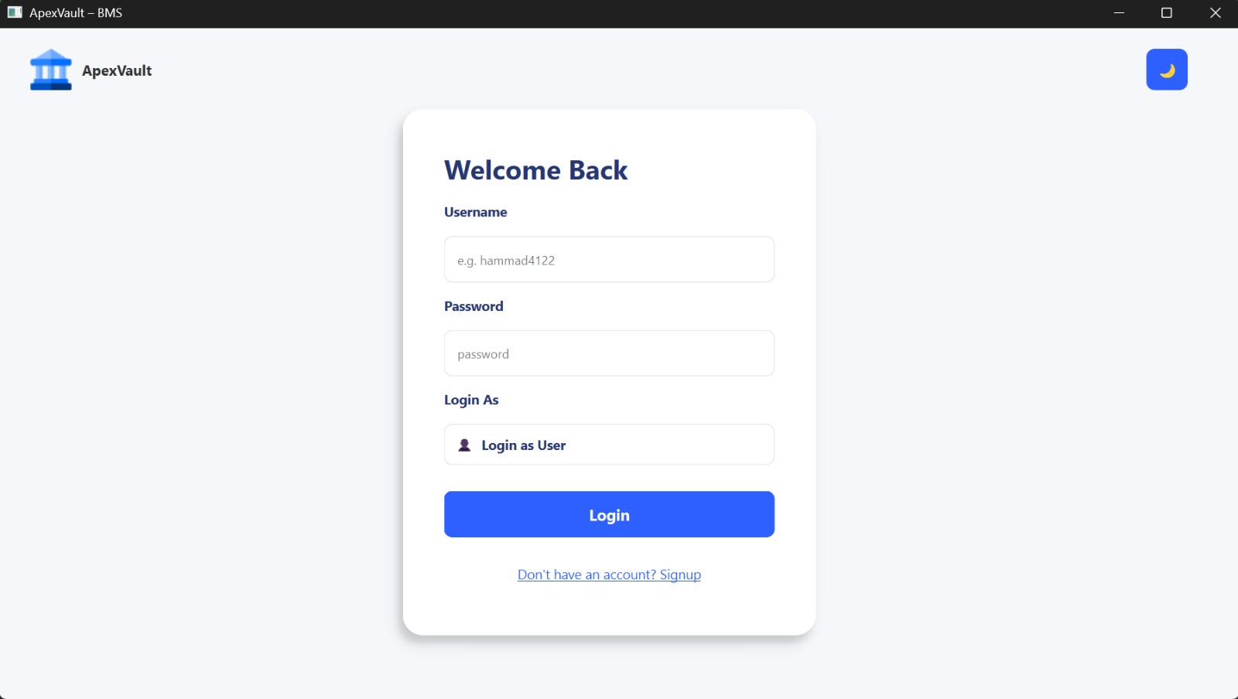
04 — UI Showcase: Login
Light Blue Theme
Light blue palette — clean professional look

Slide 11
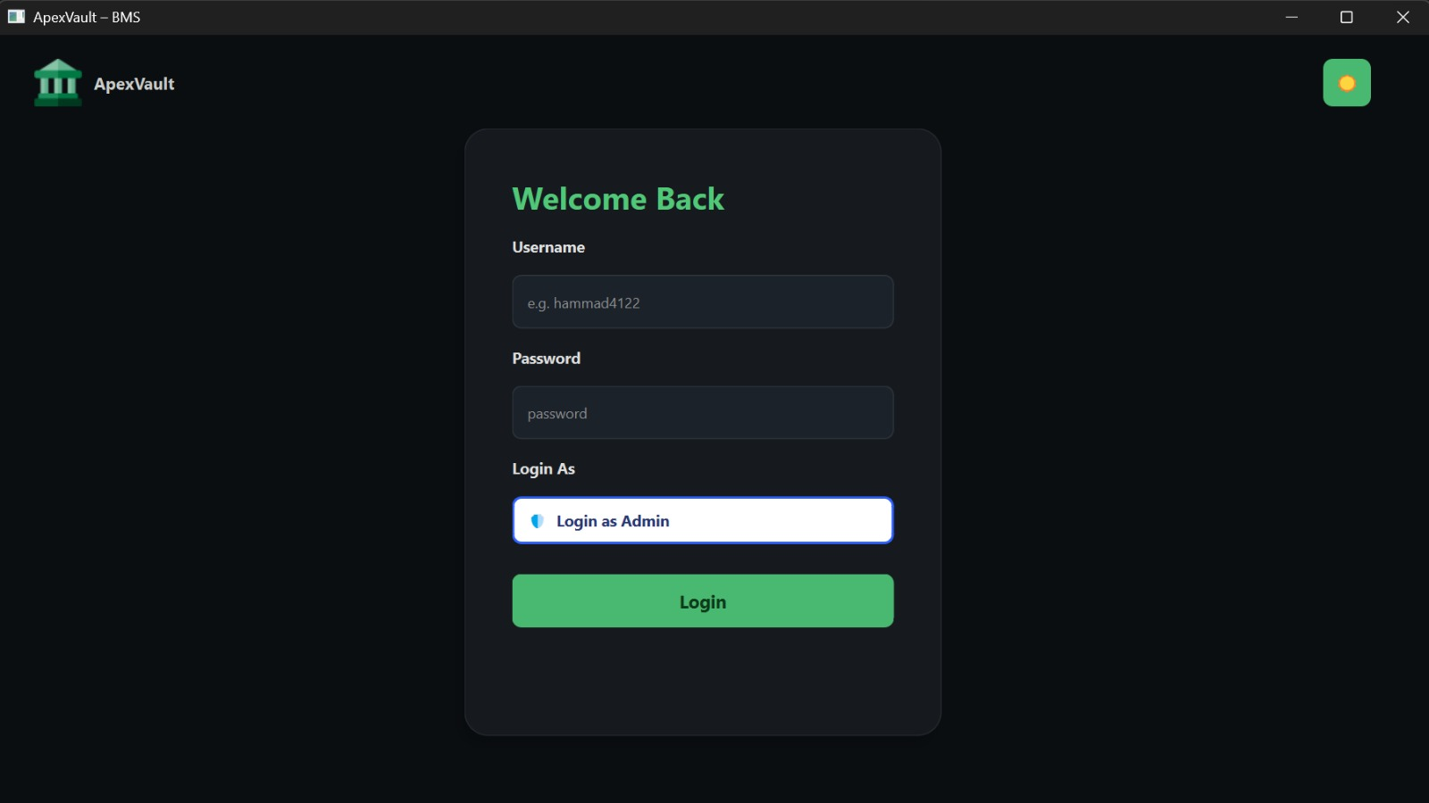
04 — UI Showcase: Login
Dark Emerald Theme
Dark emerald palette — modern premium look

Slide 12
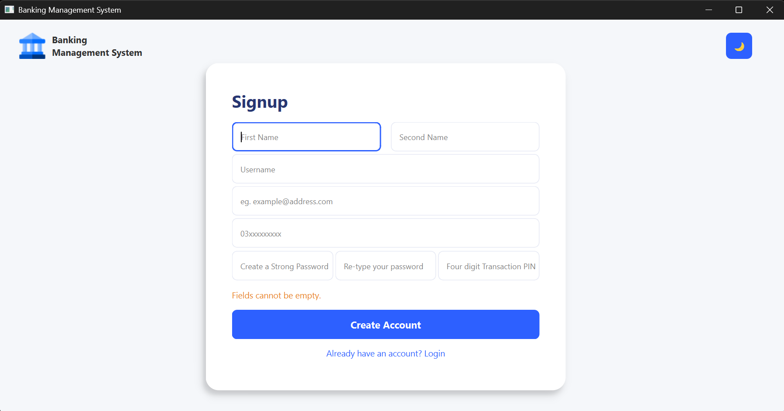
04 — UI Showcase: Signup
Light Blue Theme
Light blue palette — clean professional look
INSERT — SIGNUP — LIGHT BLUE THEME
Delete this box → Insert > Picture → select your screenshot

Slide 13
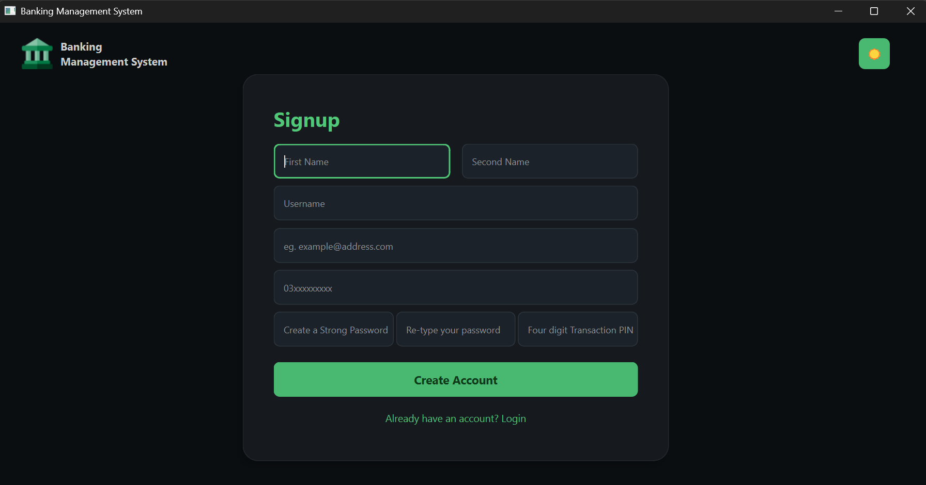
04 — UI Showcase: Signup
Dark Emerald Theme
Dark emerald palette — modern premium look
INSERT — SIGNUP — DARK EMERALD THEME
Delete this box → Insert > Picture → select your screenshot

Slide 14
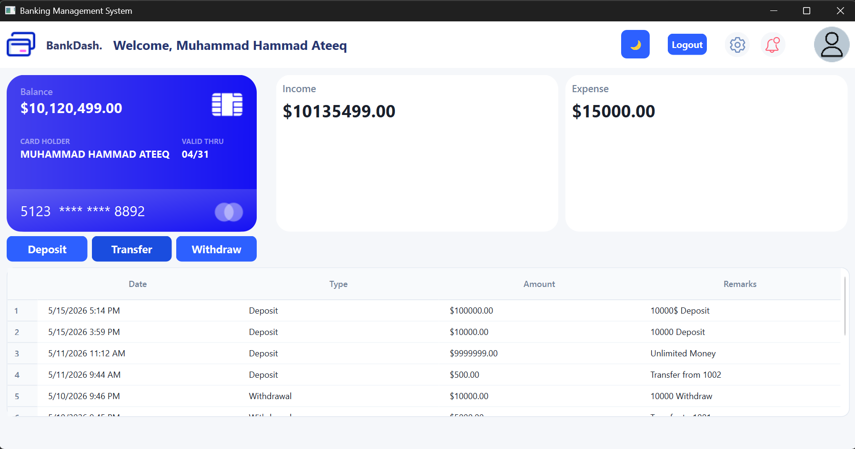
04 — UI Showcase: Dashboard
Light Blue Theme
Light blue palette — clean professional look
INSERT — DASHBOARD — LIGHT BLUE THEME
Delete this box → Insert > Picture → select your screenshot

Slide 15
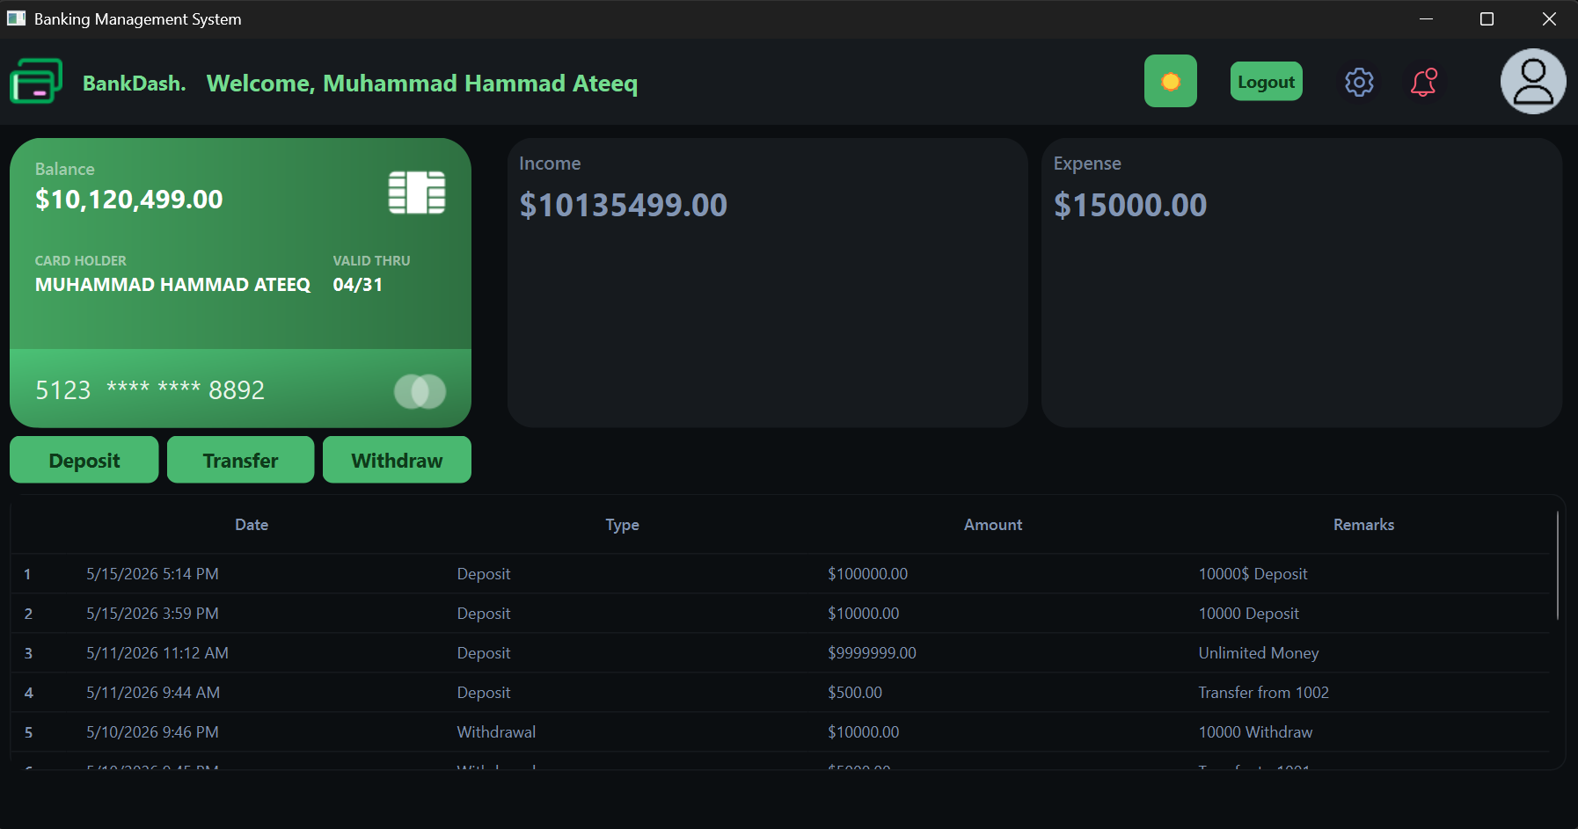
04 — UI Showcase: Dashboard
Dark Emerald Theme
Dark emerald palette — modern premium look
INSERT — DASHBOARD — DARK EMERALD THEME
Delete this box → Insert > Picture → select your screenshot

Slide 16
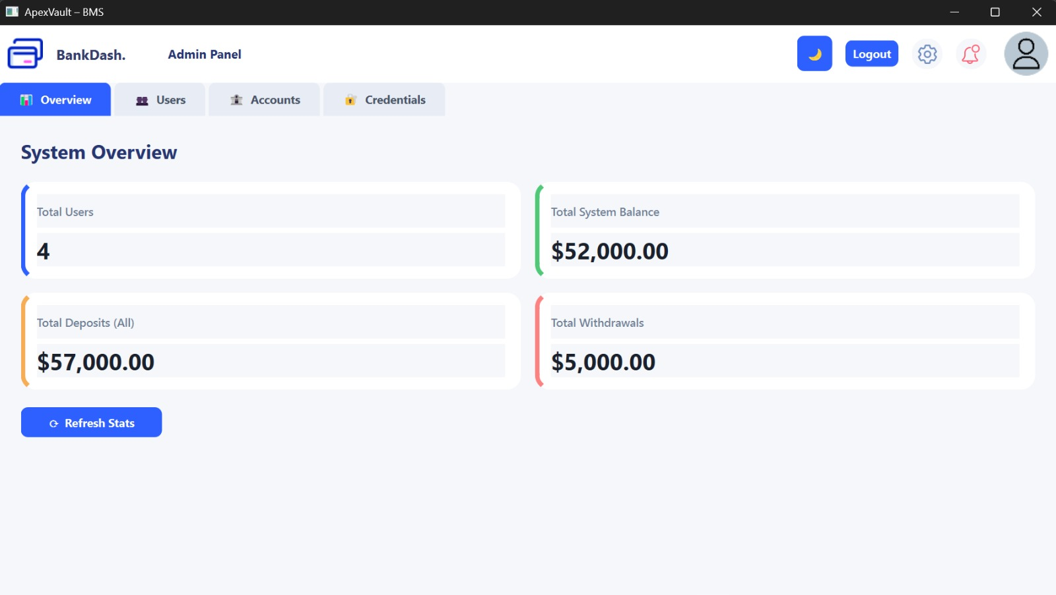
04 — UI Showcase: Admin Dashboard: Overview
Dark Emerald Theme
Dark emerald palette — modern premium look
INSERT — DASHBOARD — DARK EMERALD THEME
Delete this box → Insert > Picture → select your screenshot

Slide 17
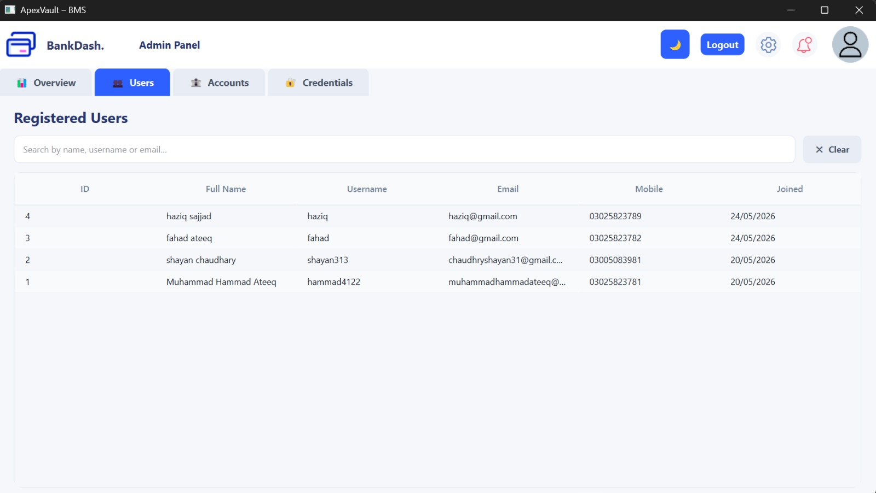
04 — UI Showcase: Admin Dashboard: Users
Dark Emerald Theme
Dark emerald palette — modern premium look
INSERT — DASHBOARD — DARK EMERALD THEME
Delete this box → Insert > Picture → select your screenshot

Slide 18
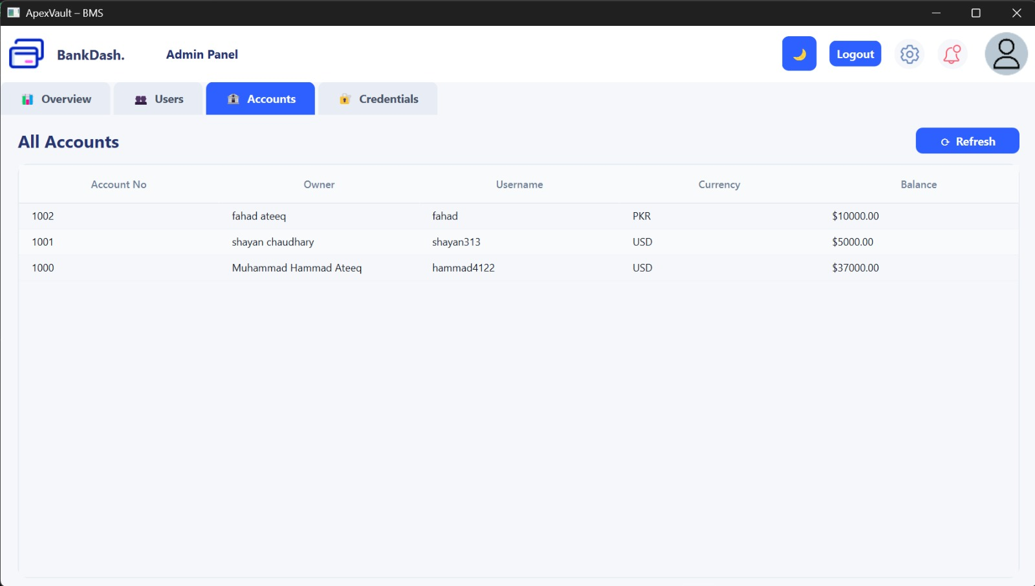
04 — UI Showcase: Admin Dashboard: Accounts
Dark Emerald Theme
Dark emerald palette — modern premium look
INSERT — DASHBOARD — DARK EMERALD THEME
Delete this box → Insert > Picture → select your screenshot

Slide 19
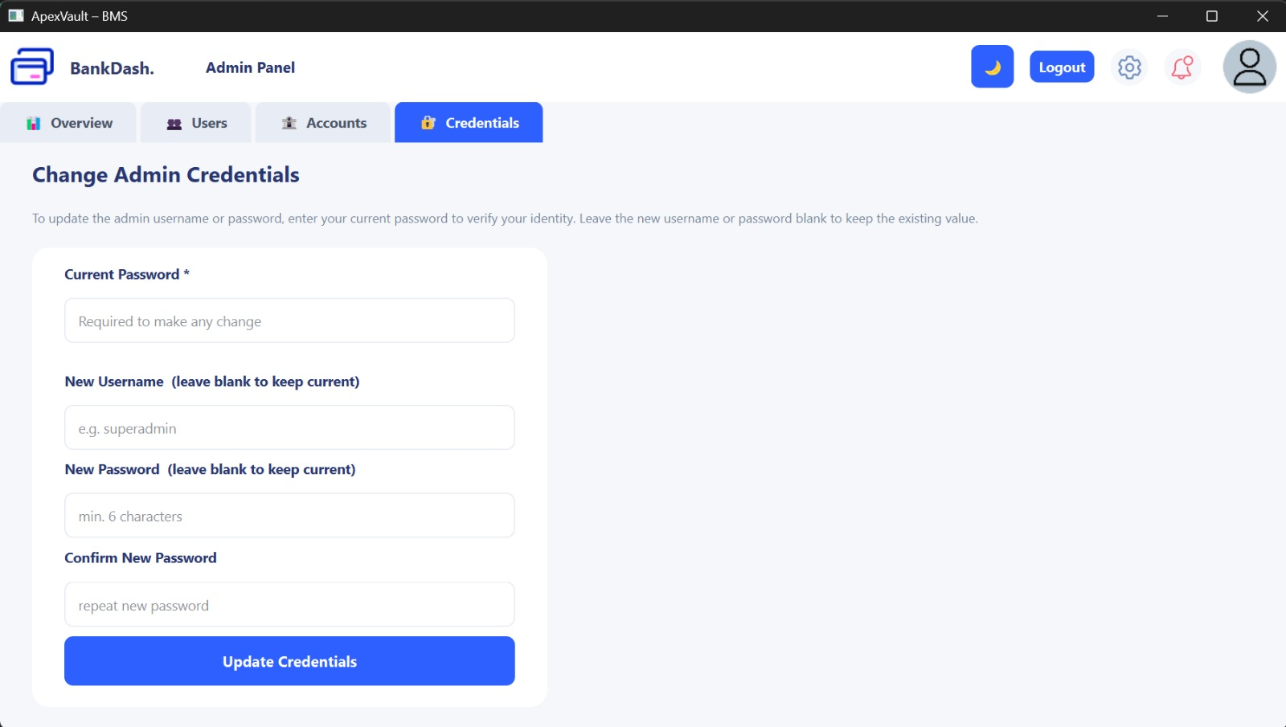
04 — UI Showcase: Admin Dashboard: Credentials
Dark Emerald Theme
Dark emerald palette — modern premium look
INSERT — DASHBOARD — DARK EMERALD THEME
Delete this box → Insert > Picture → select your screenshot

Slide 20
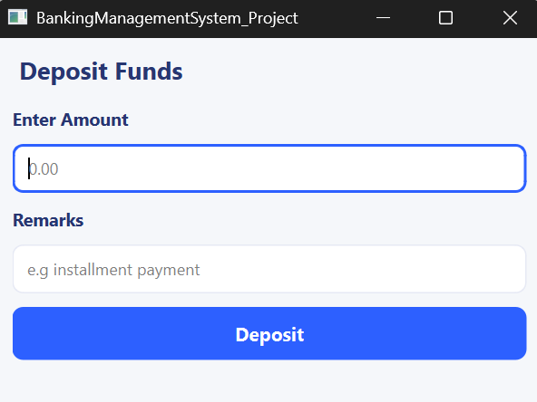
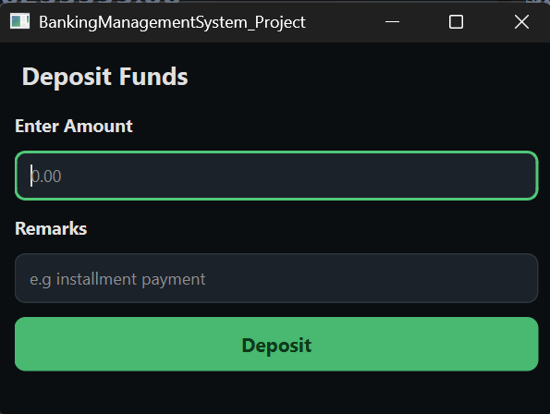
04 — UI Showcase: Deposit Dialog
Deposit funds — both themes side by side
INSERT SCREENSHOT
VS
INSERT SCREENSHOT
Deposit Dialog — Light Blue Theme
Deposit Dialog — Dark Emerald Theme
Light Blue Theme
Dark Emerald Theme

Slide 21
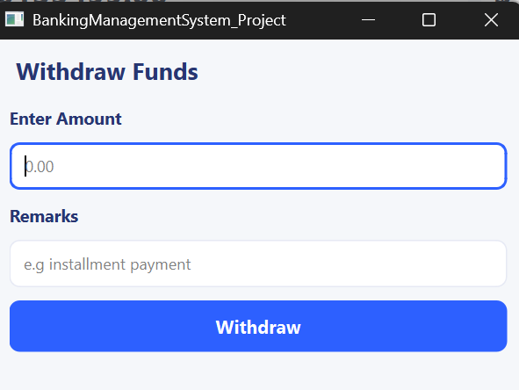
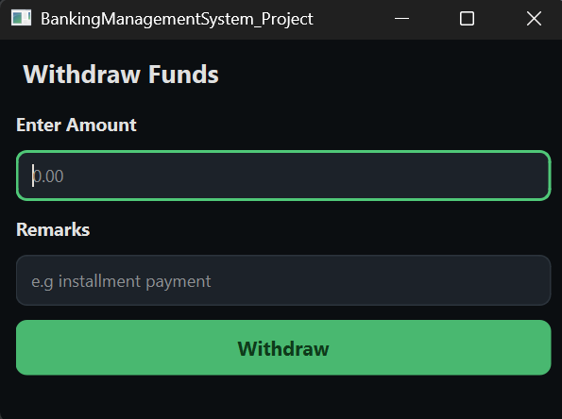
04 — UI Showcase: Withdraw Dialog
Withdraw funds — both themes side by side
INSERT SCREENSHOT
VS
INSERT SCREENSHOT
Withdraw Dialog — Light Blue Theme
Withdraw Dialog — Dark Emerald Theme
Light Blue Theme
Dark Emerald Theme

Slide 22
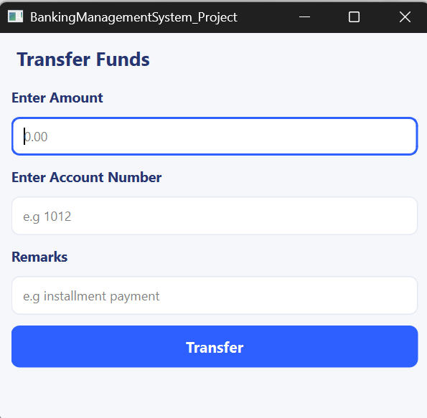
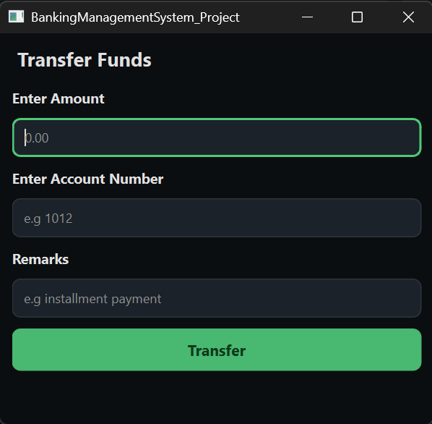
04 — UI Showcase: Transfer Dialog
Transfer to another account — both themes
INSERT SCREENSHOT
VS
INSERT SCREENSHOT
Transfer Dialog — Light Blue Theme
Transfer Dialog — Dark Emerald Theme
Light Blue Theme
Dark Emerald Theme

Slide 23
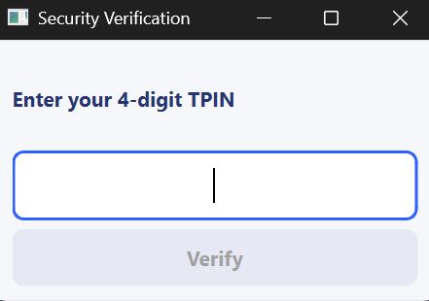
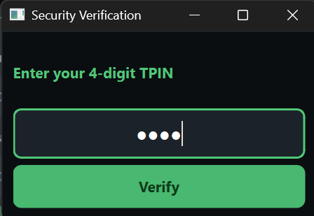
04 — UI Showcase: TPIN Dialog
Security verification popup — both themes
INSERT SCREENSHOT
VS
INSERT SCREENSHOT
TPIN Dialog — Light Blue Theme
TPIN Dialog — Dark Emerald Theme
Light Blue Theme
Dark Emerald Theme

Slide 24
04 — UI Showcase: Admin Dashboard
Admin control panel — Overview & Users tabs
INSERT SCREENSHOT
VS
INSERT SCREENSHOT
Admin Overview Tab — System-Wide Stats
Admin Users Tab — Searchable User Table
Overview Tab
Users Tab

Slide 25
04 — UI Showcase: Admin Dashboard (cont.)
Accounts & Credentials management tabs
INSERT SCREENSHOT
VS
INSERT SCREENSHOT
Admin Accounts Tab — All Account Balances
Admin Credentials Tab — Change Username / Password
Accounts Tab
Credentials Tab

Slide 26
05 — OOP Concepts: Encapsulation
Hiding internal state and exposing only clean interfaces
Encapsulation bundles data and methods into a single unit (class), restricting direct access to internal state using private/protected access modifiers.
BankDB — Data Access Layer
UserSessionHandler — Session DTO
TransactionDialog — UI Logic
› All SQL queries are private — no outside code touches the DB directly
› User ID, Account ID, Balance are private member variables
› Input fields and status labels are all private members
› Public API: loginUser(), executeDeposit(), transfer() etc.
› Exposed only through getters: getUserId(), getAccountID()
› handleInputs() and handleTransaction() are private methods
› DB connection/disconnection fully managed inside the class
› setBalance() allows controlled mutation — no raw field access
› Only the outcome (Accepted/Rejected) is communicated via signals
› Callers never see SQL strings or QSqlQuery — only results
› Prevents accidental corruption of live session state
› Full TPIN verification encapsulated inside the dialog flow

Slide 27
05 — OOP Concepts: Inheritance
Sharing common behaviour and state through a base class
BasePage
isDarkMode • db (BankDB)
applyCurrentTheme() • updateIcons()
LoginWindow
SignupWindow
DashboardWindow
· themeToggleBtn / bankLogoLabel
· Multi-field registration form
· User & Admin sub-dashboards
· handleLogin() validation
· Full validation per field
· Transaction history table
· Emits: loginSuccessful(session)
· Emits: loginRequested
· initializeUserDashboard(session)
· Emits: signupRequested
· Emits: themeChangeRequested
· Emits: logoutRequested
Benefit: All 4 page classes automatically got a working DB connection, theme engine and icon update logic — zero code duplication.

Slide 28
05 — OOP Concepts: Polymorphism
One interface, multiple behaviours — at compile time and runtime
Runtime Polymorphism
Compile-Time Polymorphism
Qt Signal/Slot Polymorphism
Virtual Functions (paintEvent)
Method Overloading
Meta-Object System
› paintEvent() is virtual — overridden in BasePage and TransactionDialog
› applyCurrentTheme() exists in BasePage, TPinDialog and TransactionDialog
› MainWindow connects themeChangeRequested signal from 3 different page types
› Qt's event system calls the correct version at runtime without knowing the type
› Same name, same purpose — different implementation per widget type
› All pages stored in QStackedWidget as QWidget pointers — fully polymorphic
› Each widget renders its background through one unified virtual interface
› Caller code is clean: dialog.applyCurrentTheme() works for any dialog
› loginSuccessful(session) triggers dashboard init via one slot
› Standard Qt pattern — required for custom QWidget painting to work correctly
› No casting needed — each class knows how to style itself
› Enables loose coupling — pages don't know about each other

Slide 29
05 — OOP: Composition, Abstraction & Best Practices
Additional OOP principles applied throughout the project
Composition
Abstraction
DashboardWindow contains BankDB and UserSessionHandler as member objects — favouring 'has-a' over 'is-a' where appropriate.
BasePage is never instantiated directly. It defines what all pages must have without specifying how each page looks or behaves.
✅ Dashboard stays independent; DB can be swapped without touching the page class.
✅ MainWindow works with any BasePage subclass generically — adding a new page needs zero changes to existing code.
Single Responsibility
Access Control
One job per class: BankDB for queries, UserSessionHandler for session, TransactionDialog for flow, TPinDialog for TPIN only.
Private members throughout: transaction helpers, DB queries, form fields. Public interfaces are deliberately minimal.
✅ Bugs are isolated — a TPIN fix didn't risk breaking dashboard rendering.
✅ Reduced accidental coupling between classes during development.
Observer (Signals/Slots)
DRY Principle
Qt's signal/slot system implements the Observer pattern — pages emit signals, MainWindow observes without tight coupling.
Stylesheets defined once in BasePage as static const QString. Validation centralised per dialog. resetForm() reuses one loop.
✅ Theme changes, login and logout events propagate cleanly without pages knowing about each other.
✅ Editing the light theme stylesheet updated Login, Signup and Dashboard simultaneously.

Slide 30
06 — Team Contributions
Individual responsibilities across the project
Muhammad Hammad Ateeq (047)
Muhammad Shayan Chaudhary (061)
Core UI Architecture
Session Management (DTO)
Designed and built LoginWindow, SignupWindow, DashboardWindow and AdminDashboardWindow using QWidgets and QLayouts, including all form fields, card widgets and the debit card layout.
Designed and built UserSessionHandler — the secure DTO holding the live user's ID, account number and balance throughout a session.
Dual Theme System
TPIN Security Dialog
Engineered the full QSS stylesheet system in BasePage — both themes — with dynamic runtime switching across all pages.
Implemented TPinDialog with 4-digit secure input, numeric validator, disabled confirm until PIN is complete, and theme-aware styling.
Transaction Engine
BasePage Foundation
Implemented TransactionDialog for all three transaction types with full input validation, TPIN flow integration and success animation.
Co-developed BasePage including the static isDarkMode flag, icon update mechanism, and applyCurrentTheme() foundation used by all pages.
Database Layer
Black-Box Testing
Built the BankDB class with all SQL queries for user management, account operations, balance retrieval, transaction logging and admin-only system-wide stats and credential management.
Led the full black-box testing phase — validating every user-facing feature: login, signup, all transactions, theme switching and error states.
MainWindow & Navigation
Bug Reporting & Fixes
Wired QStackedWidget navigation, session handoff on login, page switching signals and logout flow.
Documented defects found during testing and coordinated fixes, ensuring all edge cases (empty fields, wrong TPIN, self-transfer) were handled.

Slide 31
Thank You
Questions & Answers
We're happy to walk through any part of the code, architecture, or design decisions.
Muhammad Hammad Ateeq
Muhammad Shayan Chaudhary
Roll No. 047
Roll No. 061
Core Architecture, UI, Database, Transactions
Session DTO, TPIN, BasePage, QA Testing
Banking Management System • OOP Semester Project • BSE-2A • Bahria University

